Slide 1

Atlas Data Cleaning
January 2024
Notes:
Kickoff Brendan

Slide 2




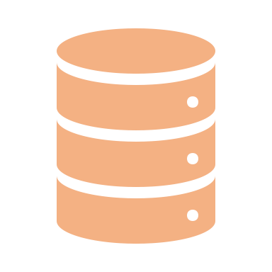

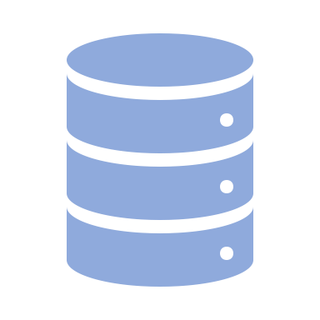
The Atlas data pipeline
Comtradeapicall Python library
Comtrade Downloader
Routinely pulls latest data from Comtrade
Comtrade Compactor
Request the raw data you want
Atlas Data Ingestion
Process data and prep for the Atlas
Bustos-Yildirim Method

Slide 3

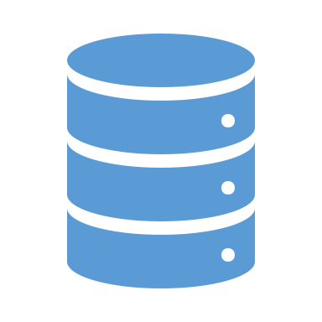
Bustos-Yildirim Method
Download Data
Calculate Inputs
1. Clean trade value totals
2. Build reliability scores
Apply reliability score to trade totals => produces Growth Lab trade values
Run complexity calculations
Ready for Atlas Ingestion
Represents a Stata file (several hundred lines of code)

Slide 4
Design Phase
Current State Overview
Access Stata data files
Stata code walkthrough (started)
E-complexity walkthrough (determine if any gaps for Atlas needs)
Determine python package for performant requirements
Delta between previous download file & new download files & impact to approach
Setup Stata code to easily execute on the cluster
Python Code Design
Integration with data downloads into atlas ingestion
Determine data inputs and outputs
Determine integration with e-complexity package
Map out Python file structure

Slide 6

Scratch Slides … might be useful later

Slide 7

Data from Comtrade
November 2023
Notes:
Brendan

Slide 8
More points of ready-access to trade data are needed
Overly reliant on a small number of people to provide
Data available for download is updated once a year
Comtrade provides more data than what’s made available from Dataverse
Comtrade recently changed their API and gave us more data

Slide 9

Comtrade introduced a new API …
more data fields
more complicated API structure
Opportunity to build a new way for the lab to access trade data

Slide 10
Comtrade gave us more data…
New data fields on trade flows and partner country attribution:
Mode of Transport
Customs procedure codes
2nd partner
Symmetrical valuation of imports and exports and insurance and freight costs
Nature of trade flows, such as re-exports, re-imports, and goods for processing, and intra-firm trade
Quantity metrics
Weight and shipping metrics
1Upgrade information for Comtrade's new 2022 API

Slide 11
Access Raw & Atlas-Ready data from the Cluster
Comtradeapicall Python library
1. Raw Comtrade data, download a compacted dataset to your specifications and requirements
Comtrade Downloader
Routinely pulls latest data from Comtrade
Comtrade Compactor
Request the raw data you want
Atlas Data Ingestion
Process data and prep for the Atlas
2. Download Atlas data directly from the Cluster. Identical data to Dataverse downloads.
Bustos-Yildirim Method
Notes:
Brendan

Slide 12
Cluster directory for Atlas Data
Uncleaned Raw Comtrade Data
/n/hausmann_lab/lab/atlas/data/raw
Sebastián’s Cleaned File
/n/hausmann_lab/lab/atlas/data/input/2023-07-11
Atlas Data
/n/hausmann_lab/lab/atlas/data/output/atlas_2023_09_19.h5
Atlas data is transitioning from HDF over to Parquet Files. A data directory is stored in the *data_tools_for_GL directory
Notes:
Brendan

Slide 13
Directory for Data Tools Notebook
/n/hausmann_lab/lab/*data_tools_for_GL/atlas_country_inclusion.ipynb
/n/hausmann_lab/lab/*data_tools_for_GL /comtrade_compactor.ipynb

Slide 14
Appendix

Slide 15
Useful links from Comtrade
reference tables

